Slide 1
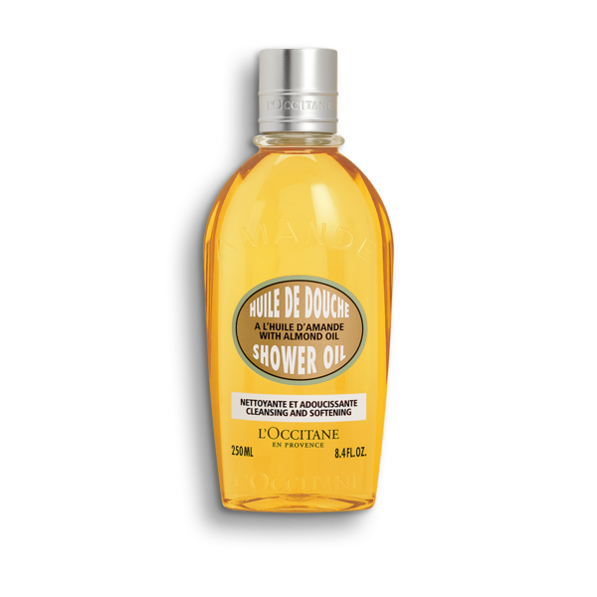
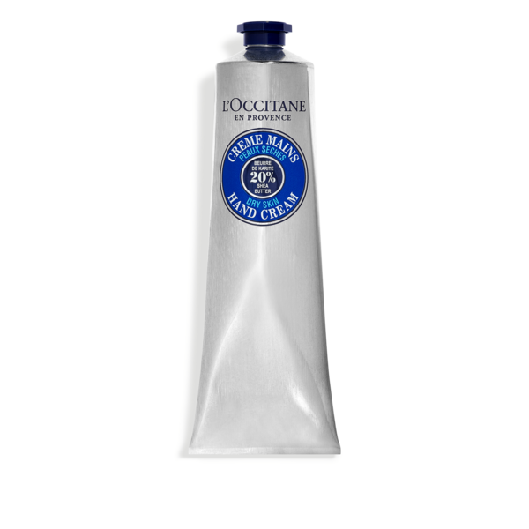
NAOCVKI003301 2022_ALM SHEA DUO_QVC
Step 1: Secure top caps of all items
Step 2: Place sticker seal on all items
Step 3: Place hand cream and alm. shower oil in shipper.
Step 4: Place in smallest shipper possible wrapped in bubble
Step 4: Place DC Barcode on the outside of the shipper
29HD250A15
01MA150K22
QVC Code: A549787
Ship Window:
6/13/22
Quantity: 1982 (1974 sales, 8 PMF)
Case Pack: 1
NAOCVKI003301 | 2022_ALM SHEA DUO_QVC
01MA150K22 | SHEA HAND CREAM 150ML
29HD250A15 | ALM SHOWER OIL 250ML

